Slide 1
Writing User Stories
Funtivity!!!

Slide 2
Things to Remember
Epic: Captures the larger body of user stories.
It can be broken into several small user stories
User Story: Smallest unit of works(known as task)
Version: The release of software to the customer
Sprint : Iteration where team does the work
2 weeks/4 weeks
Notes:
EPIC
Large body of work, contains stories
STORIES
Smallest unit of work, also known as a task
VERSION
The release of software to the customer
SPRINT
Iteration where team does the work

Slide 3
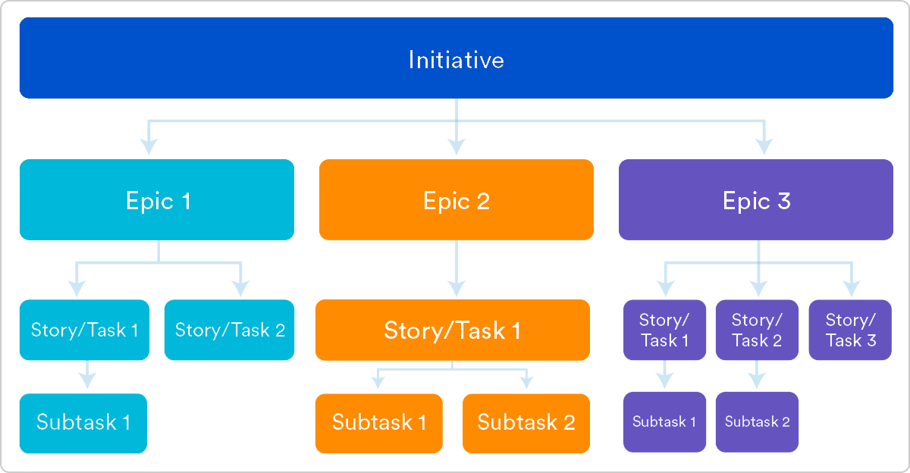
Notes:
Ref: https://www.atlassian.com/agile/project-management/epics-stories-themes

Slide 4
Things to Remember
User stories are usually written in the form
“As a [persona], I want to [do something] so that I can [derive a benefit]”
Not too broad, not too specific...Juuuuust right!

Slide 5
INVEST
• All user stories should be:
Independent (of all others)
Negotiable (not a specific contract for features)
Valuable (to the product)
Estimable (to a good approximation)
Small (so as to fit within an iteration)
Testable (in principle, even if there isn’t a test for it)

Slide 6
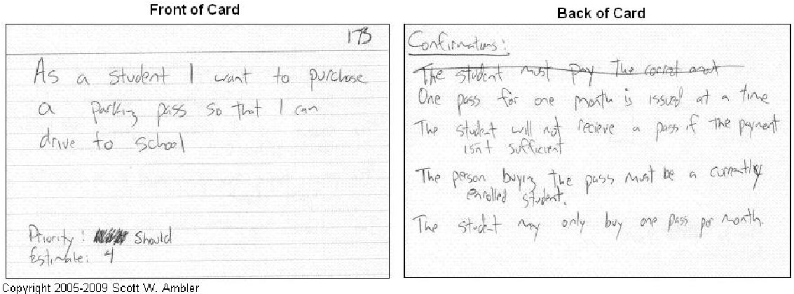
One pass for one month is issued at a time
The student will not receive a pass if the payment isn’t sufficient
The person buying the pass must be a currently enrolled student
The student may only buy one pass per month
As a student I want to purchase a parking pass so that I can drive to school
(don’t worry about priority and estimates right now)

Slide 7
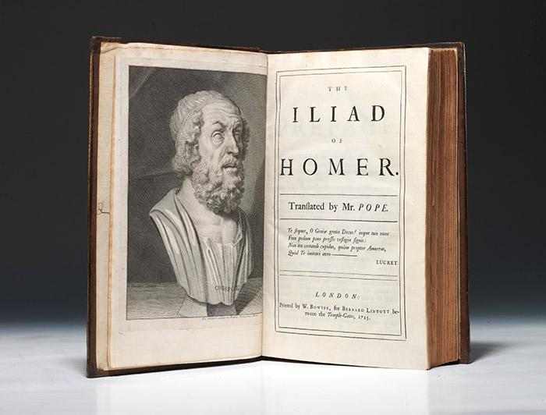
EPIC

Slide 8
As a user, I can backup my entire hard drive
Epic?

Slide 9
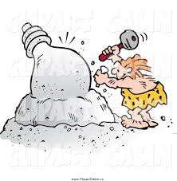
It is an epic, it is too large to complete in a single sprint (usually two weeks) because there are so many possible features that could go under this umbrella

Slide 10
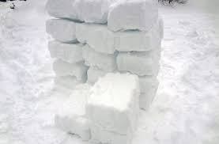
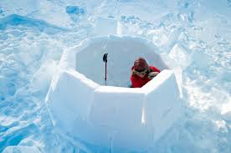
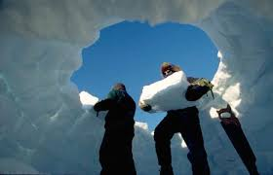
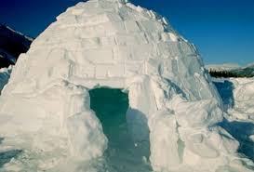
Break an epic into manageable stories
Example stories:
As a power user, I can specify files or folders to backup based on file size, date created, and date modified
(Implement a file viewer and sorting based on multiple criteria)
As a user, I can indicate folders not to backup so that my backup drive isn’t filled up with things I don’t need saved
(Implement a save/don’t save system that can be read by the backup software)

Slide 11
Now it’s your turn!
Form a group of 2 or 3 with people sitting next to you
Try to work with someone you’ve never met

Slide 12
Create a better iLearn
(that shouldn’t be too challenging)
Take 15 minutes to write a couple of epics

Slide 13
Epic
As a professor, I should be able to grade assignments so students have updated grades
Notes:
Examples if they need help getting started

Slide 14
Epic
As a student, I should be able to upload assignments so I don’t have to turn in hard copies.
Notes:
Examples if they need help getting started

Slide 15
Create a better iLearn
(that shouldn’t be too challenging)
Take 15 minutes to turn your epics into user stories

Slide 16
User Story
As a professor, I should be able to view PDF documents uploaded to the system for grading

Slide 17
User Story
As a professor, I should be able to assign a grade to a particular uploaded document/assignment so students can have digital grades

Slide 18
User Story
As a student, I should be able to upload plain text essays so I don’t have to turn in hard copies

Slide 19
User Story
As a student, I should be able to upload PDF documents so I don’t have to turn in hard copies

Slide 20
Create a better iLearn
(that shouldn’t be too challenging)
Take 15 minutes to add details and tests to your user stories

Slide 21
Details
As a professor, I should be able to view PDF documents uploaded to the system for grading
Open a PDF within the program and assign it a grade directly
Download a PDF document from the program for grading a hard copy
Batch download all students program for grading hard copies

Slide 22
Details
As a student, I should be able to upload plain text essays so I don’t have to turn in hard copies
Copy and paste text into the input field
Have bold, italics, and underline option for text
Have basic paragraph formatting
Allow for bullets, dashes, and numbered lists

